Slide 1



3rd IEEE Conference on Energy Internet
Nov. 25th-27th, 2019 Nanjing, China
Notes:
亮亮图文旗舰店
https://liangliangtuwen.tmall.com

Slide 2



Research fields
Advanced energy system
Renewable energy
Power system control
Educational background
Professor in Nanyang Technological University
Associate Professor in Auckland University of Technology
Achievements
6 books and 600 technical papers
Gao Peng
Title
Editor-in-Chief of IEEE Transactions on Smart Grid

Slide 3
Energy Internet
Based on Renewable Energy
Nanyang Technological University
Gao Peng
Notes:
亮亮图文旗舰店
https://liangliangtuwen.tmall.com

Slide 4
One
Introduction
CONTENTS
Two
Structure of energy Internet
Three
Comparison of Energy Internet
and Information Internet

Slide 5
Part One
Introduction

Slide 6

Introduction
First Proposal
American futurist Jeremy Rifkin first proposed the concept of Energy Internet.
The Concept
Energy Internet is a new form of energy industry development.

Slide 7
Introduction
Decentralization of Supply and Demand
Multi-energy Coordination
Equipment Intelligence
Information Symmetry
Flat System

Slide 8
Part Two
Structure of Energy Internet

Slide 9
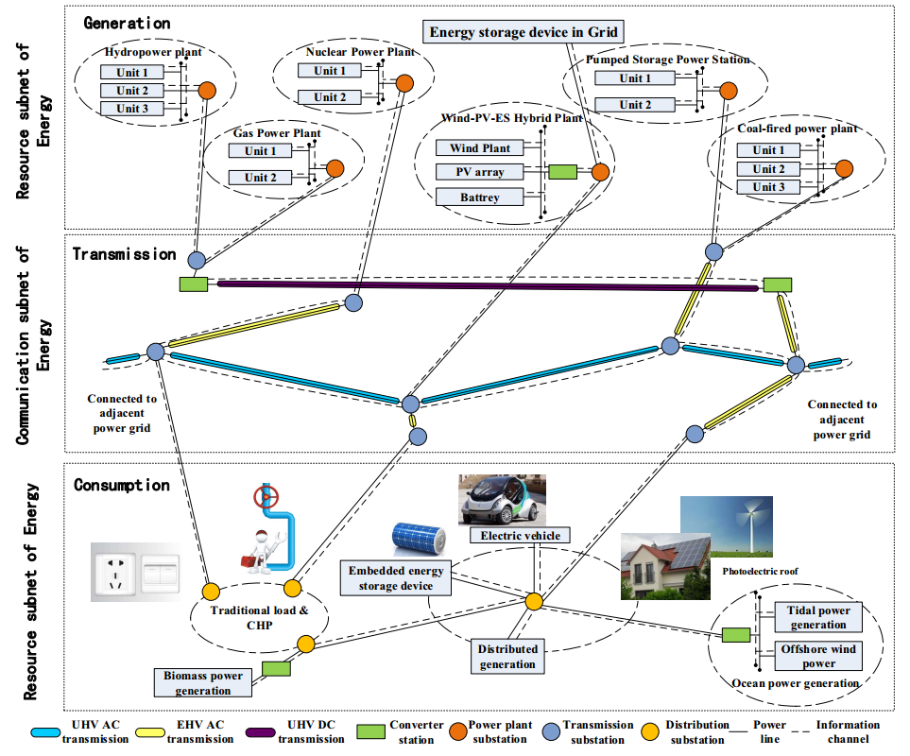
Structure of Energy Internet
Fig.1 Structure of Energy Internet

Slide 10
Part Three
Comparison of Energy Internet and Information Internet

Slide 11
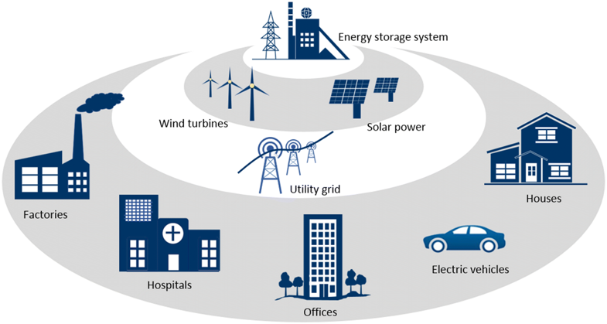
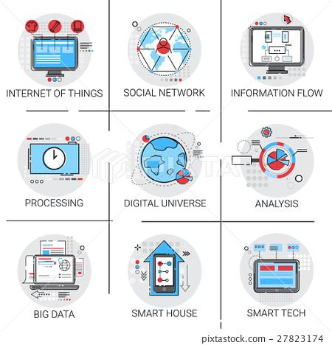
Comparison of Energy Internet and Information Internet
Similar Characteristics
Network Configuration
Fig.2 Energy Internet
Differences
Network Function, Structure, Equipment, Security and Service Object.
Fig.3 Information Internet

Slide 12
Comparison of Energy Internet and Information Internet
TABLE.I Comparsion Between EI and Information Technology
Category | Property | Energy Internet | Information Internet
Transmission process | Transmission content | Energy | Information
 | Transmission loss | Loss exist | No loss
 | Transmission direct | Simplex-based, half-duplex supplement | Full duplex

Slide 13
References
[1] Liu, Z., Global Energy Interconnection. 2016.
[2] Huang, B., et al., Distributed optimal co-multi-microgrids energy management for energy internet. IEEE/CAA Journal of Automatica Sinica, 2017. 3(4): p. 357-364.
[3] Wang, J., et al., Information technology for energy internet: A survey. Computer Research and Development, 2015. 52(5): p. 1109-1126.
[4] Liu, X., et al., A review on the energy internet. Electric Power, 2016.49(3): p. 24-33.
Gao Peng
Notes:
亮亮图文旗舰店
https://liangliangtuwen.tmall.com

Slide 14
3rd IEEE Conference on Energy Internet
Nov. 25th-27th, 2019 Nanjing, China
Notes:
亮亮图文旗舰店
https://liangliangtuwen.tmall.com

Slide 15

Educational background
Tsinghua University
Achievements
400 technical papers
More than 10 patents
IEEE Bruke Hayes Award, IEEE Outstanding Power Engineering Educator Award, IEEE Distribution Automation Award
Government subsidies
Jiao Weiran
Title
IEEE fellow, NAI fellow

Slide 16
Renewable Energy Consumption
Under the Background of Energy Internet
Tsinghua University
Jiao Weiran
Notes:
亮亮图文旗舰店
https://liangliangtuwen.tmall.com

Slide 17
Situation of China’s Renewable Energy Consumption
One
CONTENTS
Basic Connotation of Energy Internet
Two
Accommodating Technology Orienting to Energy Internet
Three

Slide 18
Part One
Situation of China’s Renewable Energy Consumption

Slide 19
Situation of China’s Renewable Energy Consumption
China’s
Renewable Energy
Number One
In the world
Consumption
Issue
TABLE.II Total Generation Curtailments of China in 2016
Provinces | Curtailments/TWH | Provinces | Curtailments/TWH
Yunnan | 320.20 | Ningxia | 23.03
Xinjiang | 168.08 | Hebei | 22.00
Sichuan | 142.00 | Heilongjiang | 20.00
Mongolia | 131.06 | Liaoning | 19.14
Gansu | 129.78 | Shanxi | 14.23
Jilin | 29.00 | Qingdao | 8.13

Slide 20
Part Two
Basic Connotation of Energy Internet

Slide 21

Basic Connotation of Energy Internet
Core——Power System
Energy
Internet
Major Power Supply——Renewable Energy
Wind
Power
Solar
Energy
Gas
Modern
Power System
Terminal
Energy
Hydro
Power
Coal
Deep Fusion
Nuclear
Power

Slide 22
Basic Connotation of Energy Internet
Energy
Internet
Flexible
Trading
Green Energies
Open
&
Free
Market
Full
Competition

Slide 23
Part Three
Accommodating Technology Orienting to Energy Internet

Slide 24

Accommodating Technology Orienting to Energy Internet
Safe Operation of power grid
01
02
Weather
Topography
Fully Accessed
to The Grid
Energy
Outputs
Limited Adjustment
Ability
Measures
of Discarding
Energy
Temperature
Geography
03
04

Slide 25
References
[1] Duncan S. Callaway, Ian A, Hiskens. Achieving Controllability of Electric loads[J]. Proceedings of the IEEE, 2011, 99(1):184-199.
[2] Sun QY, Teng F, Zhang HG. Energy Internet and Its Key Control Issues[J]. Acta Automatica Sinica, 2017, 43(2): 176-194.
[3] Fan GF, Wang WS, Liu C. Wind Power Prediction Based on Artificial Neural Network[J]. Proceedings of the Csee, 2008, 28(34): 118-123.
Jiao Weiran
Notes:
亮亮图文旗舰店
https://liangliangtuwen.tmall.com

Slide 26
3rd IEEE Conference on Energy Internet
Nov. 25th-27th, 2019 Nanjing, China
Notes:
亮亮图文旗舰店
https://liangliangtuwen.tmall.com

